Slide 1
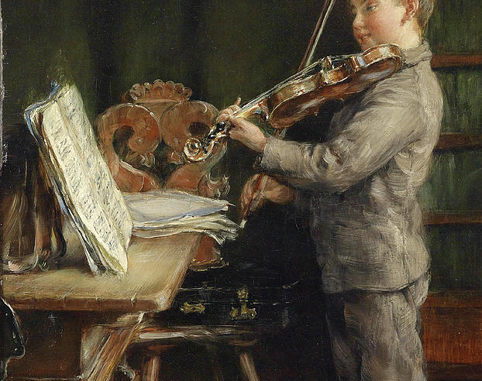
Practise Schedule
For playing little and often

Slide 2



Important Things to Practise
Warm –ups – Scales and exercises . These can be varied each day.
Etudes – or pieces of music to help build technique
Challenging pieces to learn over a longer period of time.

Slide 3

Assigning a time frame - e.g 1 hr
Warm ups – 10 minutes
Etudes – 20 minutes
Set Pieces – 30 minutes
Adjust these accordingly so that there is always a 1:2:3 ratio – this ratio doesn’t have to be strict and is only a guideline.

Slide 4
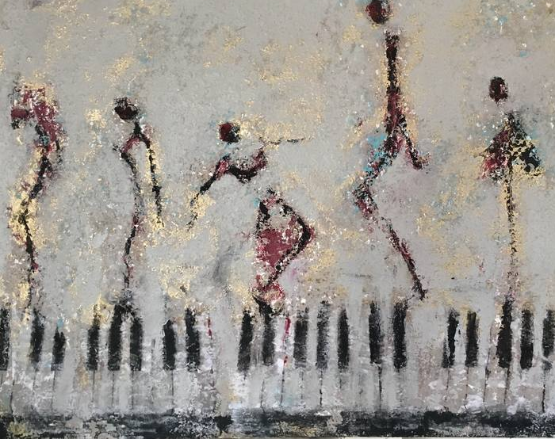
Scales- Choosing which ones to play
Obtain a small selection of scales to work on at any time.
Play scales in the key or related to the key of an etude or piece you are playing in that session
Work on scales related to etudes and exercises – for example if you are about to play an exercise using the third position, play a scale in that position.

Slide 5

There are many ways of playing scales
Adjusting the speed – using a metronome to play a scale that is a note per beat, then two notes per beat and so on.
Slurring the scales – 2 notes to a bow, then 4 notes, etc.
Playing using different parts of the bow – lower middle and upper.

Slide 6
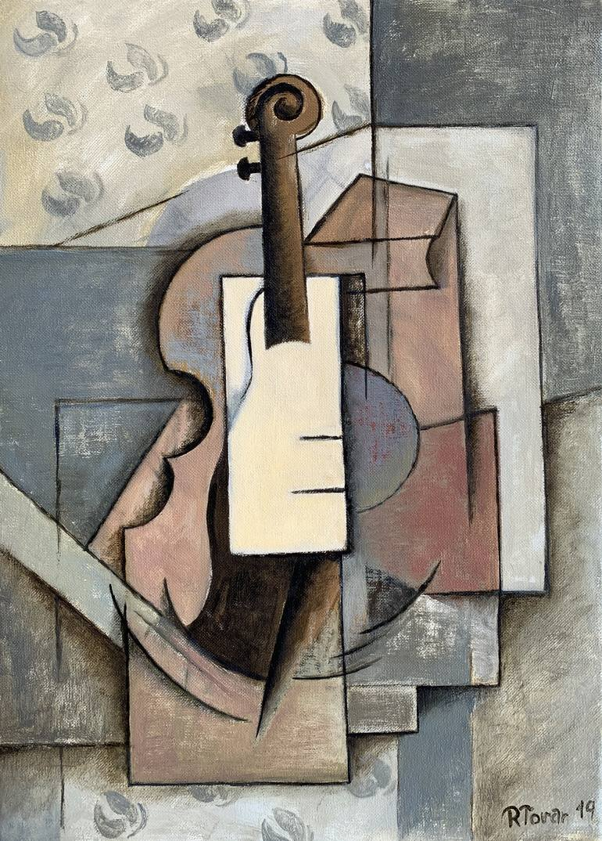
Études and pieces to help with technique
These could be repetitive types of pieces that may focus on a select few techniques.
They can be of different lengths and difficulties so it may be good to have a small selection at a time.
Long etudes can be split up so one can focus on a section each day.

Slide 7
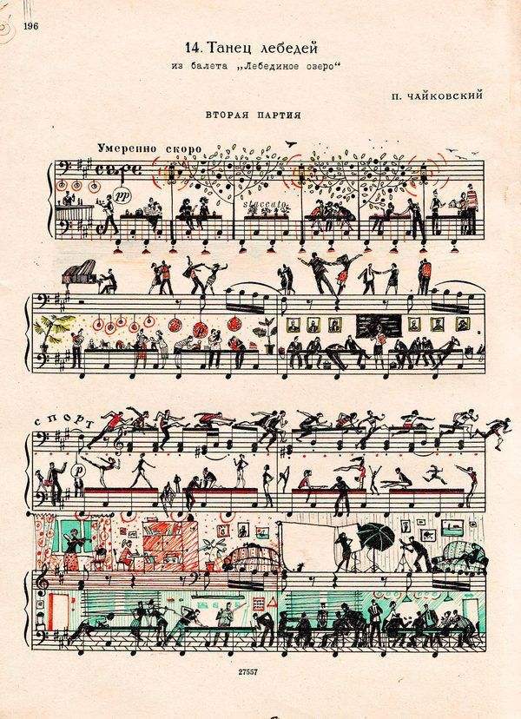
Examples of Étude Books for Violin
Found on IMSLP
Charles Dancla Beginner Etudes
H.E Kayser 36 Elementary and Progressive Studies
Franz Wohlfahrt 60 Studies for the Violin

